Slide 1



Python: Beyond the Basics
Andrew Ortego
James Bennett

Slide 2


About this Presentation
All notebooks can be downloaded at https://github.com/BeyondTheBasics2017/UC2017
Use Jupyter Notebook installation included with Pro 2.0 (for ArcPy code)
Notebooks provide a convenient way to write, run, and share code
Preferred method for using the ArcGIS Python API
Learn more about these concepts after presentation
Consider how they could be used in your current work flow(s)
Swing by the Spatial Analysis and GP islands for additional questions

Slide 3
Today’s Topics
Functions
Data Structures
Iterators
Comprehensions
Geometry Objects
Script Tools
3rd Party Modules

Slide 4
Modules: Included with Python
requests: send HTTP requests
json: work with json data
Encoding, decoding
zipfile: create and extract from zipfiles
Resources:
Python help: Global Module Index
Python module of the week

Slide 5
Modules: Included with ArcGIS
numpy: n- dimensional array
Spatial Analyst, arcpy.da conversion functions
matplotlib: Graphing and Charting
Spatial Statistics visual outputs
xlrd / xlwt: read and write excel files
Used in the excel toolset
Resources:
Python help: Global Module Index
Python module of the week

Slide 6


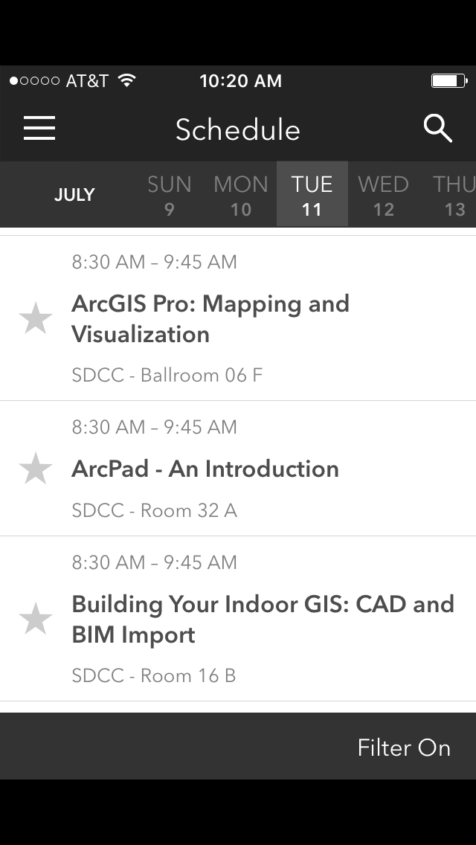
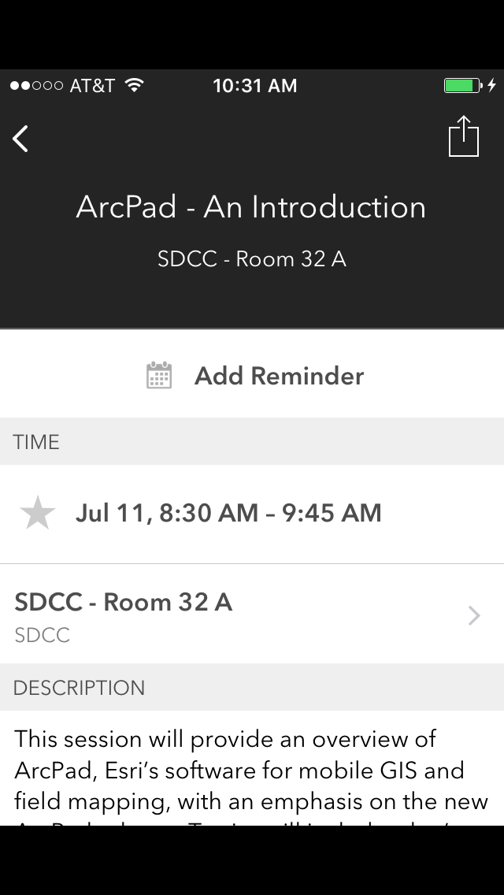
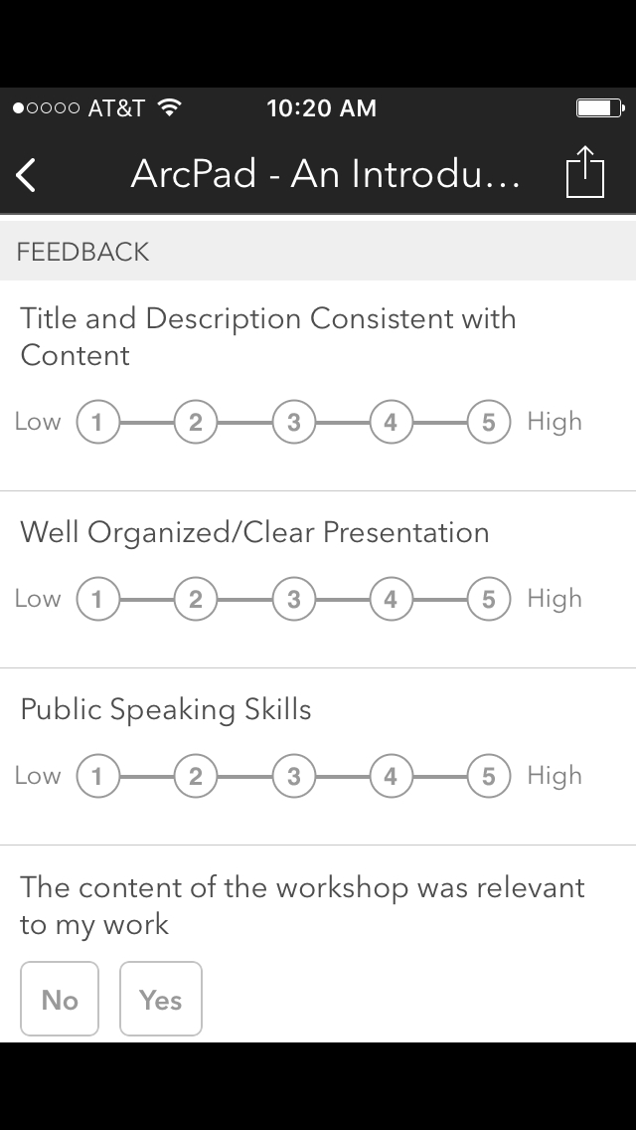
Please Take Our Survey on the Esri Events App!
Download the Esri Events app and find your event
Select the session you attended
Scroll down to find the survey
Complete Answers
and Select “Submit”

Slide 7



